Slide 1
به نام خدا
درس: زبان تخصصی
استاد: میثم سعیدی
نام: مهدی میری
شماره دانشجویی: 4022333057

Slide 2
Backhand welding
معنی: جوشکاری پشتی
Backhand welding is a welding technique in which the worker welds the objects from left to right. Also known as pull welding, it involves applying the torch before the rod itself.
Although there are exceptions, backhand welding is typically included to about a 15-degree angle on the worker’s right side. The worker is then able to add the filler metal from his left side.

Slide 3
Brazing
معنی: لحیم کاری
Brazing, process for joining two pieces of metal that involves the application of heat and the addition of a filler metal.
This filler metal, which has a lower melting point than the metals to be joined, is either pre-placed or fed into the joint as the parts are heated.
In brazing parts with small clearances, the filler is able to flow into the joint by capillary action. The temperature of the molten filler used for brazing exceeds 800° F (430° C).
In a related process called soldering, the filler metal remains below that temperature. Brazed joints are usually stronger than soldered joints

Slide 4
Carbon ARC cutting
معنی: برش قوس کربنی
Air carbon arc cutting, also referred to as metal arc gouging, and previously as air arc cutting, is an arc cutting process where metal is cut and melted by the heat of a carbon arc.
Molten metal is then removed by a blast of air.
It employs a consumable carbon or graphite electrode to melt the material, which is then blown away by an air jet.
This process is useful for cutting a variety of materials, but it is most often used
for cutting and gouging aluminum, copper, iron, magnesium, and carbon and stainless steel. Because the metal is blown away by the air jet, it does not need to be oxidized.
This process differs from plasma cutting operations because in air
carbon cutting an open, unconstricted arc is used, and the arc operates separately from the air jet.

Slide 5
Cold welding
معنی: جوشکاری سرد
Cold welding or contact welding is a solid-state welding process in which joining takes place without fusion or heating at the interface of the two parts to be welded.
Unlike in fusion welding, no liquid or molten phase is present in the joint.

Slide 6
Edge joint
معنی: اتصال لبه
Edge joints are a type of welded joint where two members are joined along their edges. These joints are commonly used when the members need to be joined in a linear configuration.
There are several types of edge joints, each with its own characteristics and applications.

Slide 7
Face shield
معنی: محافظ صورت
A face shield, an item of personal protective equipment (PPE), aims to
protect the wearer's entire face (or part of it) from hazards such as flying
objects and road debris, chemical splashes (in laboratories or in industry), or
potentially infectious materials (in medical and laboratory environments).
Depending on the type used, a face shield may protect its wearer from a physical
hazard, chemical splashes, or biological hazards

Slide 8
Fillet weld
معنی: فیله جوش
Fillet welding refers to the process of joining two pieces of metal together when they are perpendicular or at an angle.
These welds are commonly referred to as tee joints, which are two pieces of metal perpendicular to each other, or lap joints, which are two pieces of metal that overlap and are welded at the edges.
The weld is triangular in shape and may have a concave, flat or convex surface depending on the welder's technique. Welders use fillet welds when connecting flanges to pipes and welding cross sections of infrastructure, and when bolts are not strong enough and will wear off easily

Slide 9
Forge welding
معنی: جوشکاری فورج
Rather than heating the materials until they become a molten metal, the heat causes plastic deformation at the weld surfaces before they are pushed together to create a metallic bond between the atoms in the metals.
Forge welding is an ancient and versatile process of joining that has been a staple of traditional blacksmithing for centuries.
Able to join both similar and dissimilar metals, the manual process has been largely superseded by electrical and gas welding methods, although automated forge welding is still a common process in manufacturing.

Slide 10
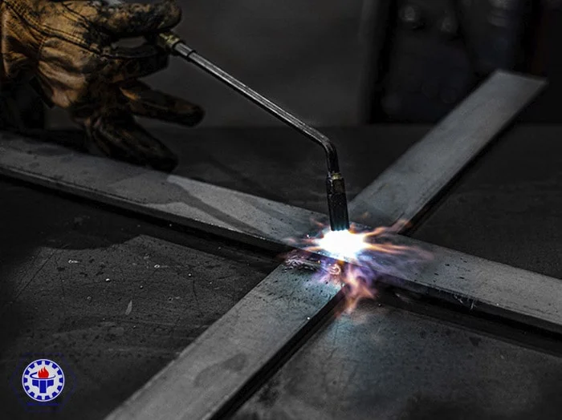
Slot welds
معنی : جوش شکافی
A slot weld joins the surface of a piece of material to another piece through an elongated hole.
The hole can be open at one end and can be partially or completely filled with weld material. In the Model Tree, solid slot welds are
represented by , light slot welds are represented by , and surface slot welds are represented by

Slide 11
Fusion
معنی: ذوب
Fusion, or synthesis, is the process of combining two or more distinct entities into a new whole.

