Slide 1
Project 1
10 words from tl1 file
Presented by: mahan karim khani
Master: Dr.maysam saidi
Razi university 24 esfand

Slide 2
Table of Content
Antifriction Bearings
Inoculate
Clandestine
Insulating
Emission
Abrasive & Refractory
Impurities
brazing alloy
Billet
Transparent Substance Crucible
purifying
Razi university

Slide 3
Inoculate:
The pronunciation of “inoculated” is /ɪˈnɒkjʊle/
refers to the process of introducing a vaccine or immunologically active material into a person or an animal. This is done to stimulate the immune system to develop protection against a disease, effectively treating or preventing it. The term can also be used more broadly to mean introducing something into an organism or environment1.
Here’s an expanded explanation with examples:
Medical Context: A child is inoculated with a vaccine to provide immunity against diseases like measles or polio. This involves injecting a weakened or dead form of the pathogen to stimulate the body’s immune response without causing the disease1.
Environmental Context: In agriculture, plants may be inoculated with beneficial bacteria to promote growth or protect against pests.
01
Razi university

Slide 4
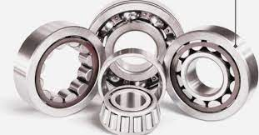
02
Antifriction Bearings:
Pronunciation: /æntiːfrɪkʃən beərɪŋz/.
These are also known as rolling contact bearings, used to accommodate a load with rolling elements placed between two races. They are capable of bearing heavy radial and axial thrust loads depending on their type.
Antifriction Bearing types
Razi university

Slide 5
Clandestine:
The pronunciation of “clandestine” is /klænˈdestɪn/
refers to activities that are conducted in secrecy, often because they are illegal or unauthorized. The term is commonly associated with espionage, covert operations, and other activities that require discretion and concealment from the public eye or authorities. For example, a clandestine meeting might take place in a hidden location to discuss sensitive matters without attracting attention. Similarly, clandestine surveillance is carried out to gather information without the knowledge of the subject.
03
Razi university

Slide 6
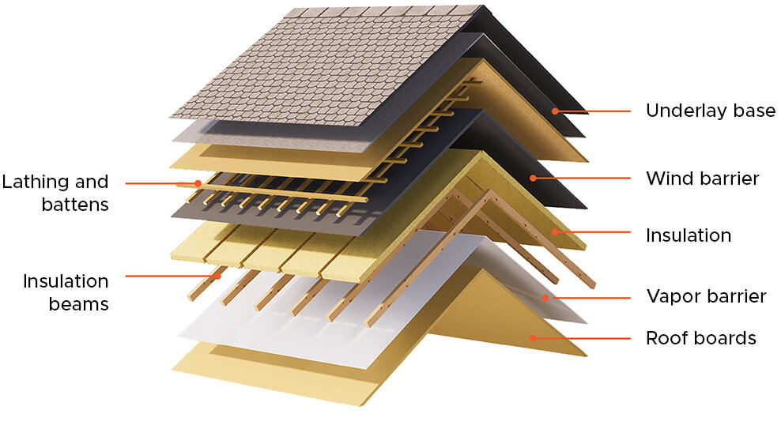
Insulating:
The pronunciation of “insulating” is indeed /ˈɪnsjʊˌleɪt/
refers to the process of applying a material to prevent the transfer of heat, sound, electricity, or other forms of energy. It’s a critical aspect in various fields, from construction to electronics, as it enhances energy efficiency and safety. Insulation materials are chosen based on their ability to reduce unwanted heat loss or gain and can also serve to dampen sounds.
For instance, in buildings, insulation is used to keep the interior environment comfortable and to reduce energy costs. Materials like fiberglass, mineral wool, cellulose, and foam are commonly used for this purpose1. Each material has different properties and is selected based on the specific requirements of the application, such as thermal resistance (R-value), flammability, and environmental impact.
In the context of electrical engineering, insulating materials are used to coat wires and other components to prevent electrical currents from escaping, which could lead to malfunctions or hazards.
04
Razi university

Slide 7
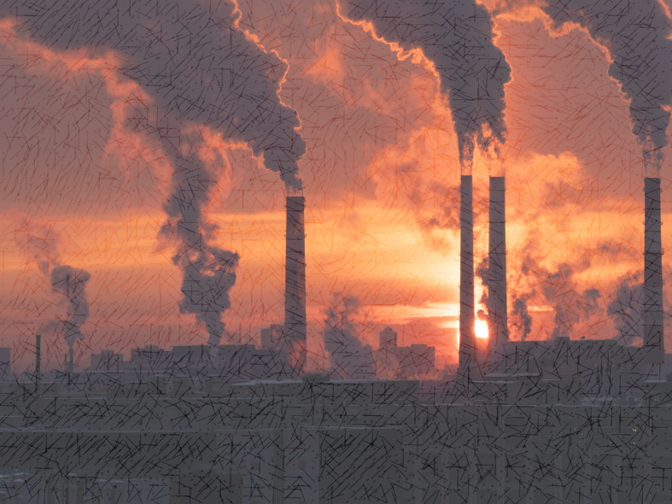
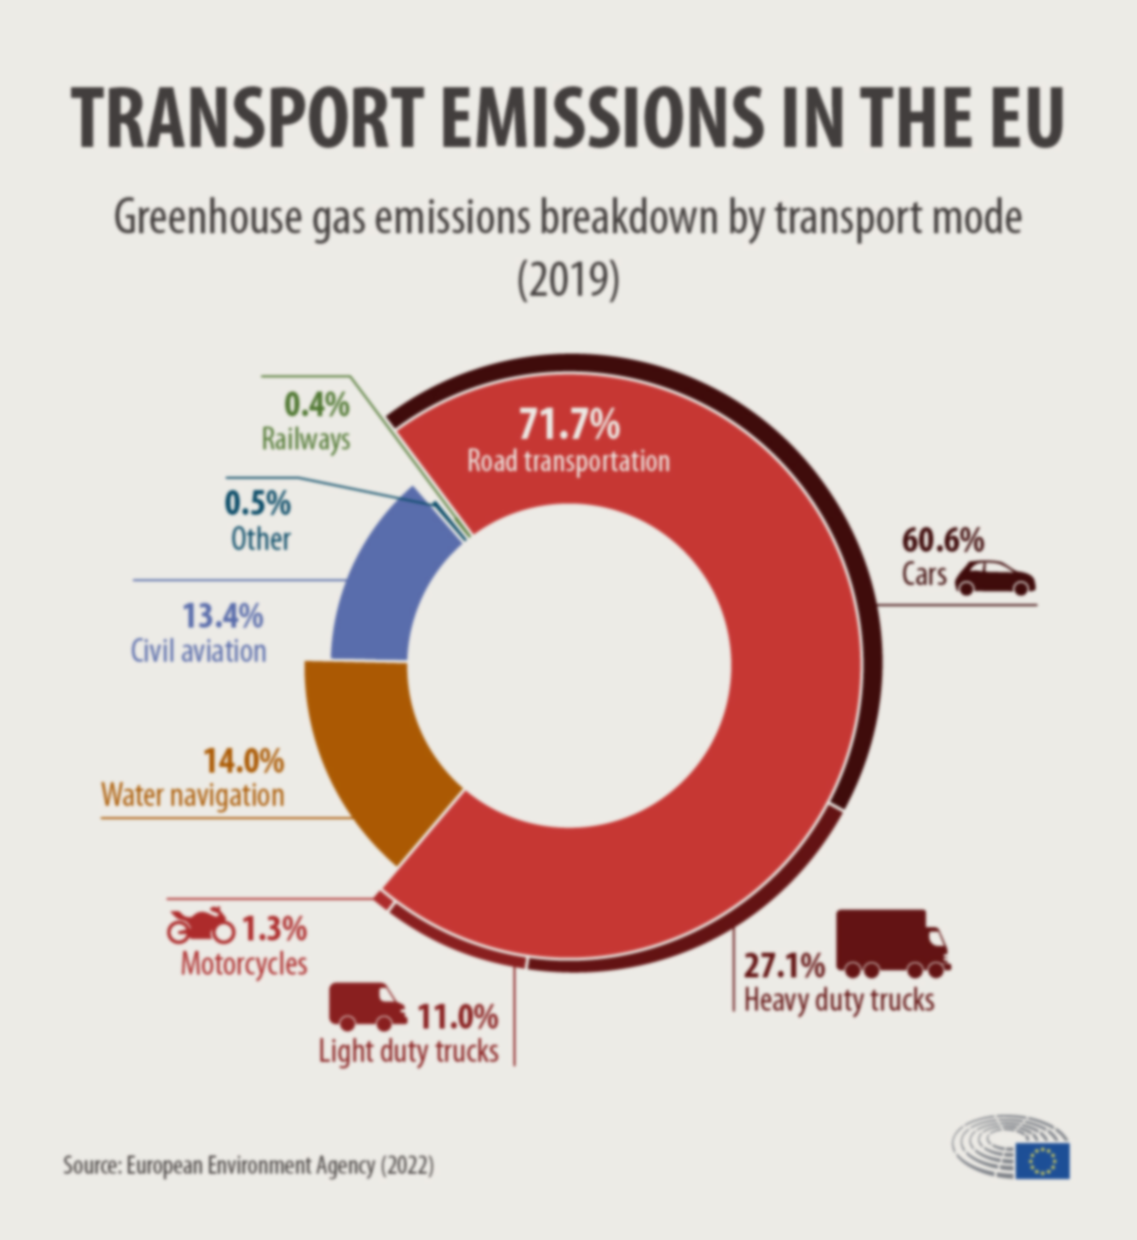
Emission:
The pronunciation of “emission” is /iˈmɪʃ.ən/
refers to the act of emitting or discharging something, such as light, heat, or gas. It can also relate to the amount of a substance that is produced and sent out into the environment, which can be harmful, especially in the case of carbon dioxide and other greenhouse gases1. Here are some examples of emissions:
Light Emission: Bioluminescence is the emission of light from living organisms like fireflies or deep-sea creatures.
Heat Emission: Thermal cameras can detect heat emissions from objects, which are invisible to the naked eye.
Gas Emission: Factories may emit gases as a byproduct of manufacturing processes, which can contribute to air pollution
05
Razi university

Slide 8
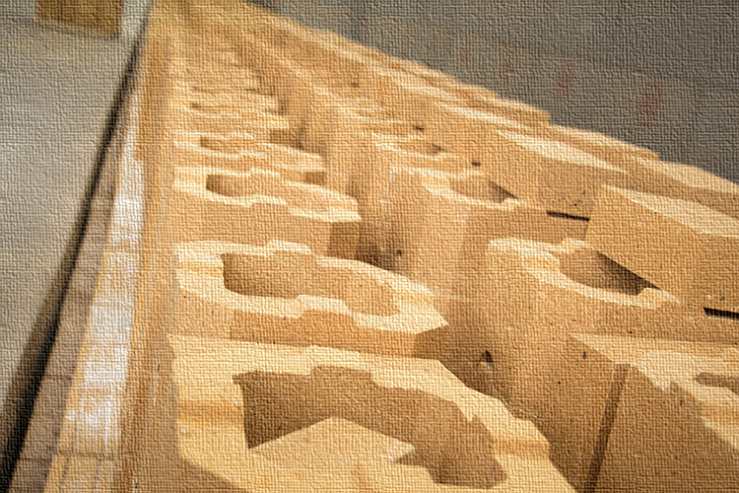
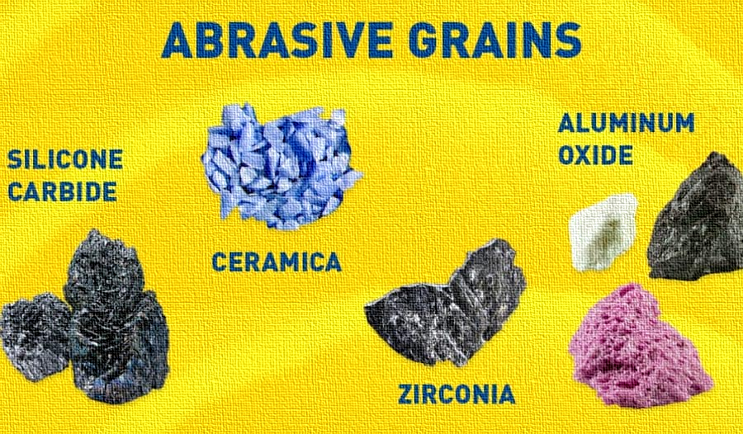
06
Refractory materials and abrasive materials:
The pronunciation for “refractory” is /rɪˈfræk.tər.i/ and for “abrasive” is /əˈbreɪsɪv/
Refractory materials are those that can withstand high temperatures without melting or breaking down. They are essential in industries where heat resistance is crucial, such as in the lining of furnaces, kilns, and reactors1. Common refractory materials include oxides of silicon, aluminum, and magnesium.
On the other hand, abrasive materials are used to wear down, clean, or finish surfaces through friction. They come in various forms, from natural substances like garnet to synthetic ones like silicon carbide and diamond, the hardest known material2. Abrasives are used in a wide range of applications, from industrial grinding to household cleaning.
Razi university

Slide 9
07
Impurities:
The pronunciation of “impurities” is /ɪmˈpjʊrɪtiːz/
are substances found in small amounts within another substance, which can compromise its purity or quality. These can be natural or introduced during production or handling. In chemistry, impurities can affect the physical and chemical properties of materials, and their removal is often essential for certain applications.
For example:
Metals: Impurities like ash or debris can weaken the metal’s structural integrity.
Water: Chemicals or biological contaminants can render water unsafe for consumption.
Semiconductors: Even trace amounts of impurities can significantly alter electrical conductivity.
08
Razi university

Slide 10
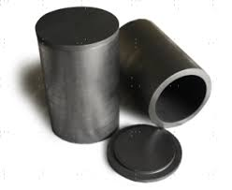
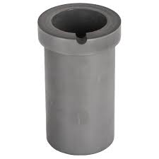
Transparent Substance Crucible:
the pronunciation for “Transparent Substance Crucible” would be /trænsˈpær.ənt ˈsʌb.stəns ˈkruː.sɪ.bəl/
08
A container that can withstand very high temperatures and is used for metal, glass, and pigment production as well as a number of modern laboratory processes.
A crucible, particularly one that is transparent, is a specialized container designed to withstand extremely high temperatures. It’s used in various industrial and laboratory processes, such as the production of metals, glass, and pigments. The transparency of the crucible is particularly useful in processes where visual monitoring of the contents is necessary.
Crucibles are typically made from materials like porcelain, alumina, or graphite, which can endure the high-temperature conditions found in furnaces and kilns1. For instance, in the production of glass, a crucible would be used to melt silica sand along with other ingredients like calcium oxide and sodium carbonate to create a transparent substance.
Effect of crucible material on the grain refinement of A3003 alloy.
Razi university

Slide 11
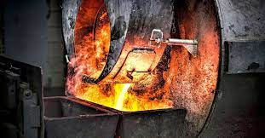
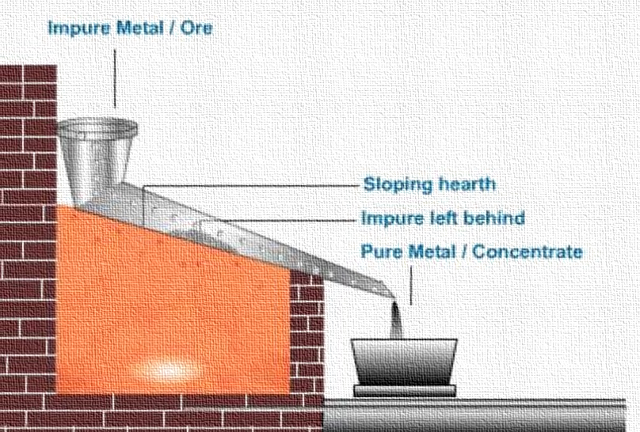
Purifying:
The pronunciation of “purifying” is /ˈpjʊrɪfaɪɪŋ/
is the process of making something pure by removing substances that are dirty, harmful, or not wanted. It’s a term widely used in contexts such as water treatment, air purification, and the refining of metals and other materials. The goal of purification is to isolate the desired substance in its purest form, free from contaminants or impurities.
For example:
Water Purification: Involves processes like filtration, sedimentation, and distillation to remove contaminants from water, making it safe for drinking.
Air Purification: Uses filters and scrubbers to remove pollutants and allergens from the air.
Metal Refining: Includes methods like electrolysis and zone refining to purify metals like gold and silicon.
10
09
Razi university

Slide 12
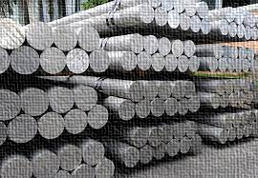
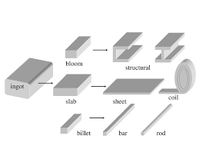
10
Billet:
The pronunciation you provided is also correct: /ˈbɪlɪt/.
A billet is a length of metal that has a round or square cross-section, with an area less than 36 in^2. Billets are created directly via continuous casting or extrusion or indirectly via hot rolling an ingot or bloom. Billets are often used as raw material in the manufacturing of other metal products.
What is Steel Billet?
Razi university

Slide 13
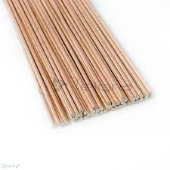
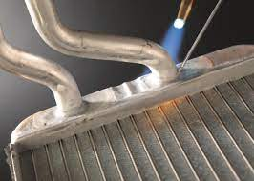
11
brazing alloy:
The pronunciation is : /ˈbreɪzɪŋ ˈælɔɪ/
A brazing alloy is a metal that is added during the brazing process to form a bond between the parts being joined. Brazing alloys are often made of a mixture of metals such as silver, copper, and nickel. They melt at high temperatures and flow into the joint between two close-fitting parts, creating a strong, sealed joint when cooled. This process is commonly used in plumbing, electronics, and even jewelry making.
Razi university

Slide 14
Thank You
For Watching

