Slide 1
بسم الله الرحمن الرحیمر
In the name of god
Reza Abdolmaleki
English language project
Student code : 402 011 1128

Slide 2
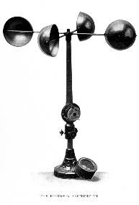
ANEMOMETER – An instrument for measuring the velocity of flow of a gas, either by mechanical or electrical methods
باد سنج

Slide 3
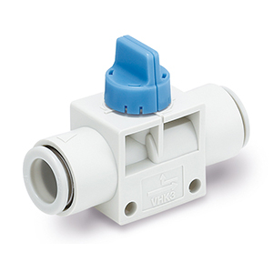
FINGER VALVES – Valves consist of narrow strips of stainless steel, fastened to the seat at one end and free to flex along their length. Suitable for light service
شیر انگشتی

Slide 4
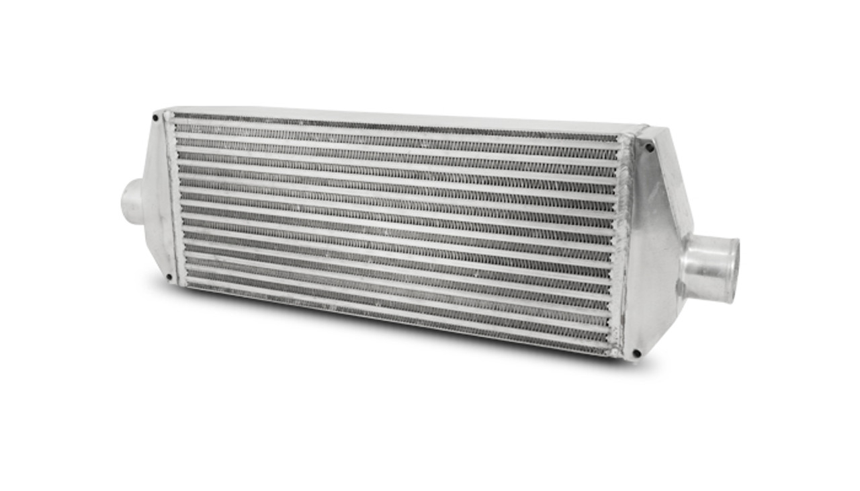
INTERCOOLER – A type of surface heat exchanger placed between two cylinders of a two stage compressor so that heat of compression generated in the first stage cylinder may be removed (in part or whole) from the air as it passes through the intercooler to the second stage cylinder.
خنک کن میانی

Slide 5
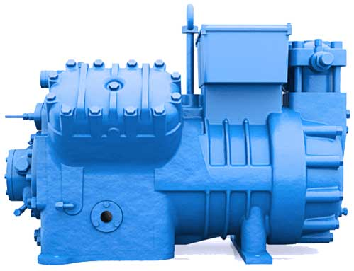
RECIPROCATING COMPRESSOR – A compressor having a piston which is made to move to and fro, that is forward and backward and thereby compresses and delivers air
کمپرسور رفت و برگشتی

Slide 6
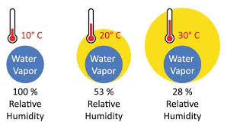
RELATIVE HUMIDITY – Degree of saturation of the air with water vapour as determined by the use of the wet and dry bulb thermometers
رطوبت نسبی

Slide 7
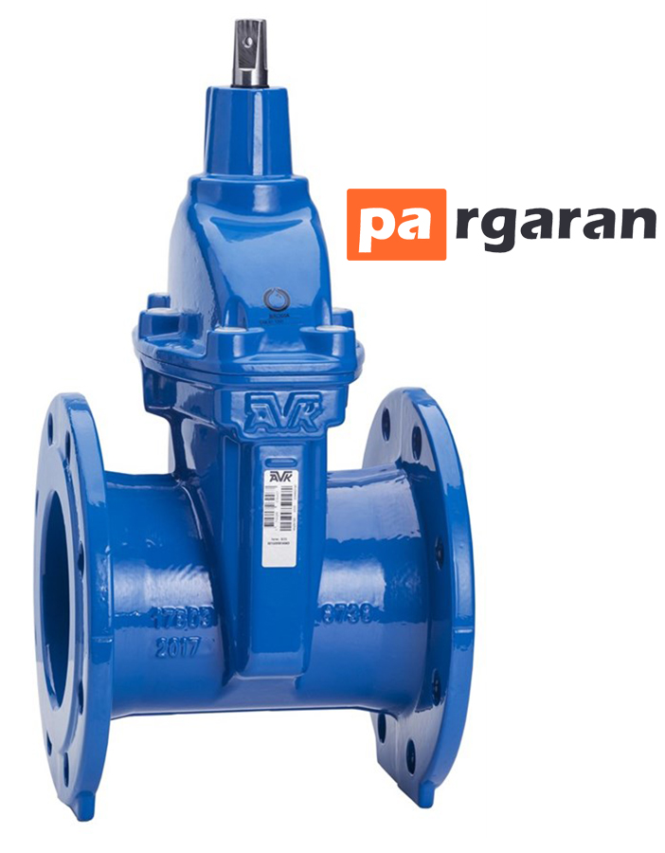
VALVE GEAR – The mechanism or combination of parts by which a reciprocating or to and fro motion is imparted to the valve from the rotary motion of the shaft.
شیر دروازه ای

Slide 8
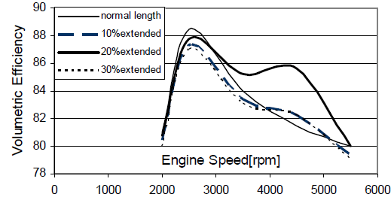
VOLUMETRIC EFFICIENCY – The ratio of the actual number of cubic meter of free air (at 1.03 kscm abs and 15° C) compressed per unit of time to the number of cubic meter of piston displacement during that time
بازده حجمی

Slide 9
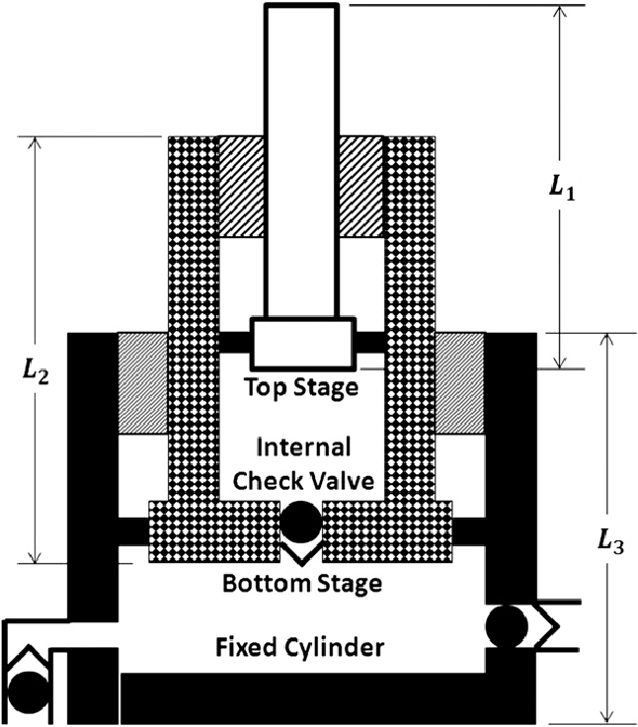
TWO STAGE CYLINDER – A cylinder of special construction with a step piston, the low pressure being at the top while the high pressure is formed around the trunk
سیلندر دو مرحله ای

Slide 10
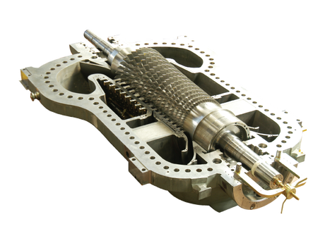
AXIAL COMPRESSOR – A multistage, high efficiency compressor comprising alternate rows of moving and fixed blades attached to a rotor and its casing respectively. The flow of fluid is essentially parallel to the axis of the compressor
کمپرسور محوری

Slide 11
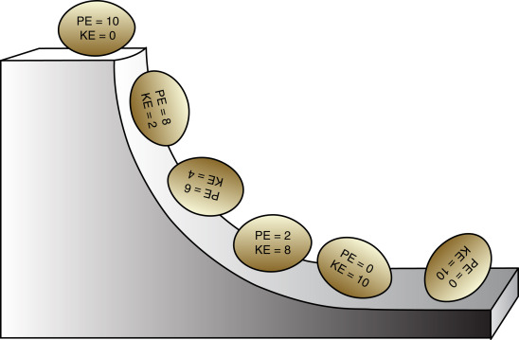
CONSERVATION OF ENERGY – Energy can be transmitted from one body to another or transformed in its manifestations, but can neither be created nor destroyed
پایستگی انرژی

