Slide 1
به نام خدای مهربان
پروژه اول زبان تخصصی
کلمات فصل ۴
استاد :آقای دکتر میثم سعیدی
دانشجو: مبینا بالایی

Slide 2
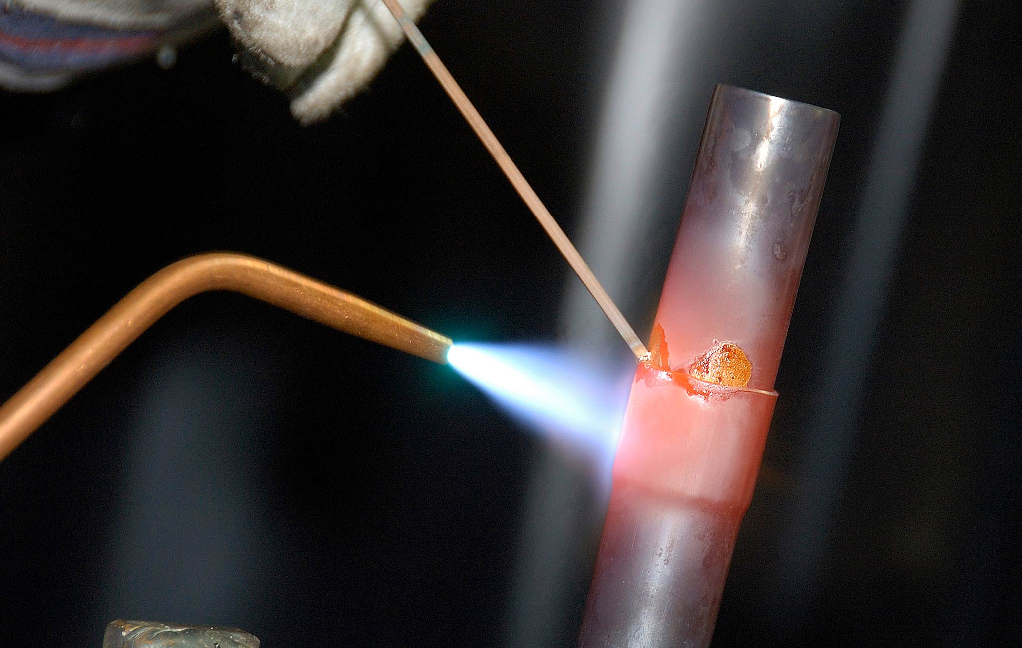
BRAZING – Joining two pieces of metal without melting either one by using a brazing alloy (copper zinc alloy i.e., brass) that melts at a lower temperature than the materials being joined
BRAZING
CASTING
FORGING
MILLING
STAMPING
WELDING

Slide 3
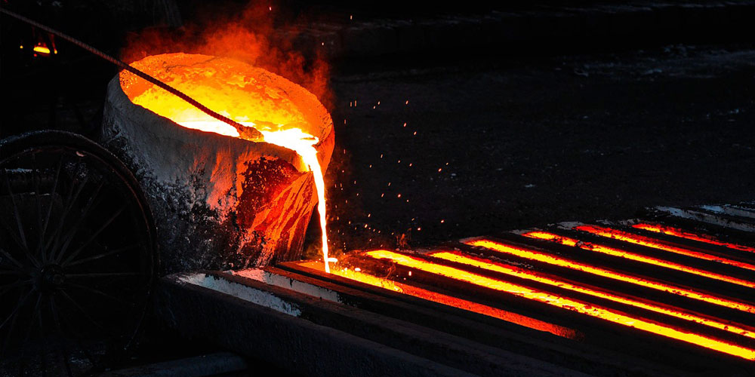
Process of producing a metal object by pouring molten metal into a mould.
BRAZING
Casting
ریخته گری
CASTING
FORGING
MILLING
STAMPING
WELDING

Slide 4
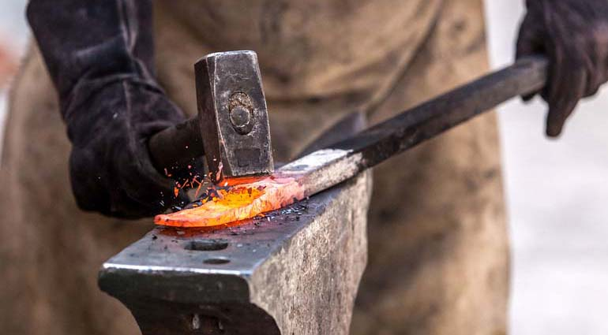
A method of metal working in which the metal is hammered into the desired shape,
or is forced into a mould by pressure or hammering,
usually after being heated to a more plastic state.
Hot forging requires less force to form a shape than that of cold forging,
which is usually done at room temperature
BRAZING
CASTING
Forging آهنگری
FORGING
MILLING
STAMPING
WELDING

Slide 5
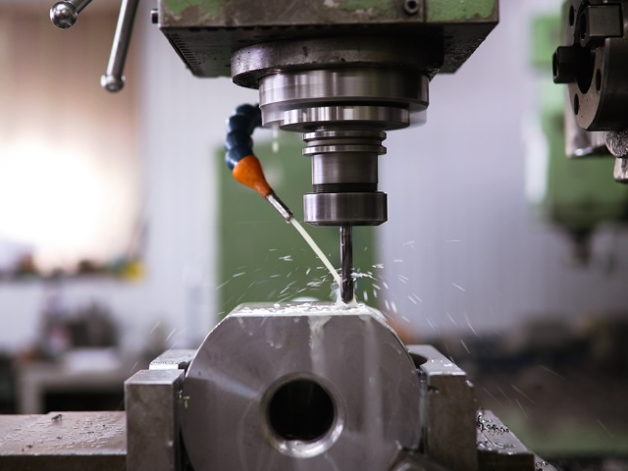
Operation in which a workpiece is given a specific shape or
form by means of a rotating cutter having many cutting teeth.
Operation in which a workpiece is given a specific shape or form by means of a rotating cutter having many cutting teeth.
BRAZING
Milling
فرزکاری
CASTING
FORGING
MILLING
STAMPING
WELDING

Slide 6
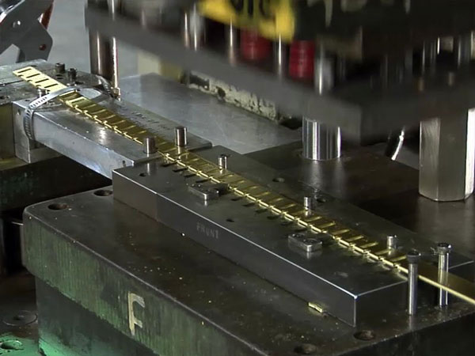
Process of shaping metal under a falling weight
BRAZING
STAMPING
مهر زدن
CASTING
FORGING
MILLING
STAMPING
WELDING

Slide 7
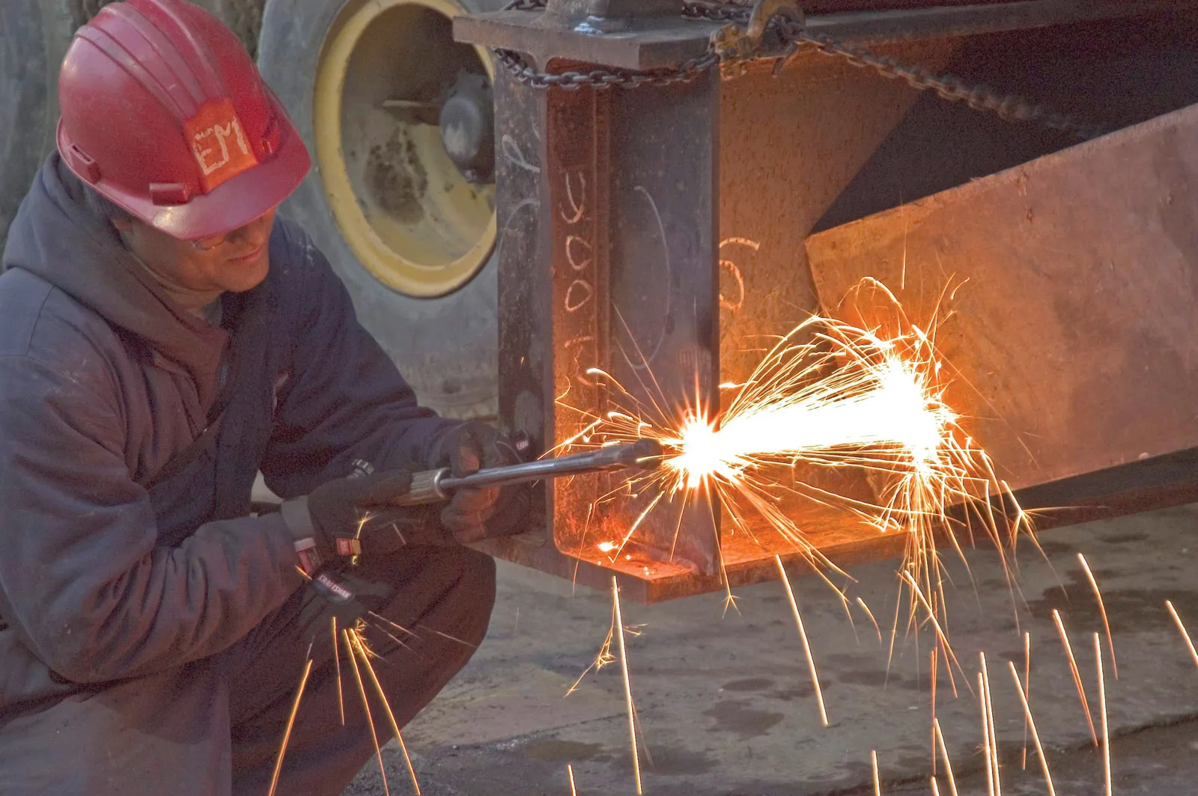
Joining of metals by the application of heat, without the use of solder or any other metal or alloy having a lower melting point than the metals being joined
BRAZING
WELDING
جوشکاری
CASTING
FORGING
MILLING
STAMPING
WELDING

Slide 8
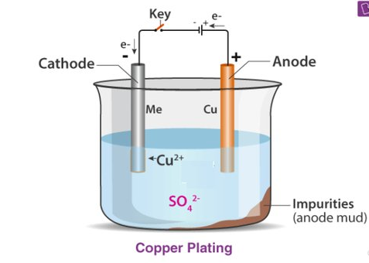
The process of depositing a layer of one metal on another, often done electrically, for the purpose of corrosion protection, appearance, improved electrical conductivity, and other engineering requirements
PLATING
COINING
MACHINING
SMELTING
Conclusion

Slide 9
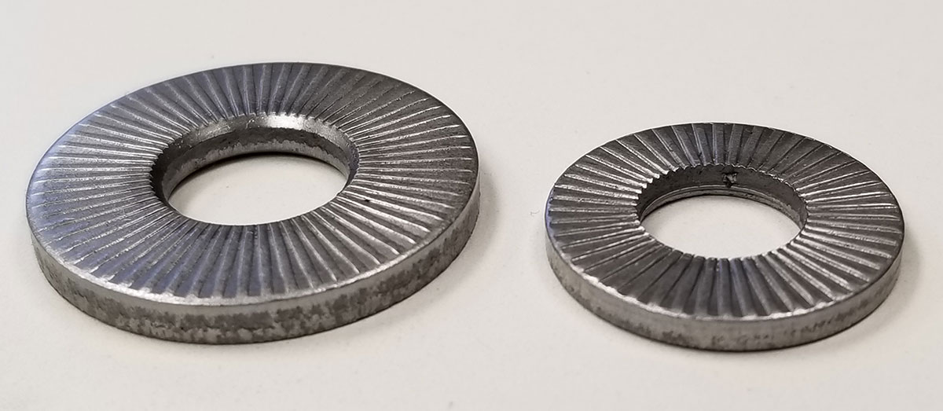
Process of producing a metal object by pouring molten metal into a mould.
COINING (embossing)
سکه زدن‌‌ نقش برجسته ایجاد کردن
PLATING
COINING
MACHINING
SMELTING
Conclusion

Slide 10
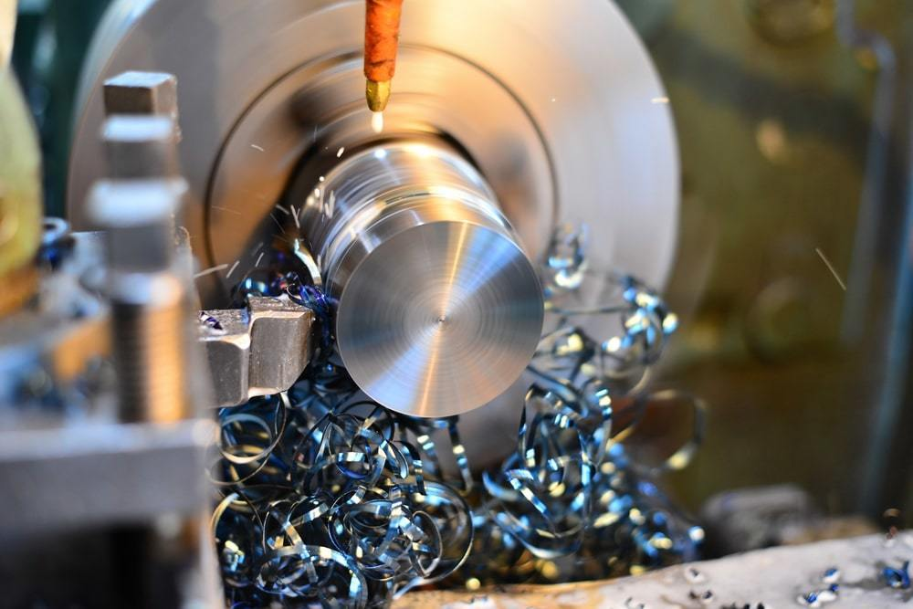
Machining is the art of using machine tools and cutting tools in combination to reduce a piece of material to some specified shape and dimensions.
PLATING
MACHINING ماشین کاری
COINING
MACHINING
SMELTING
Conclusion

Slide 11
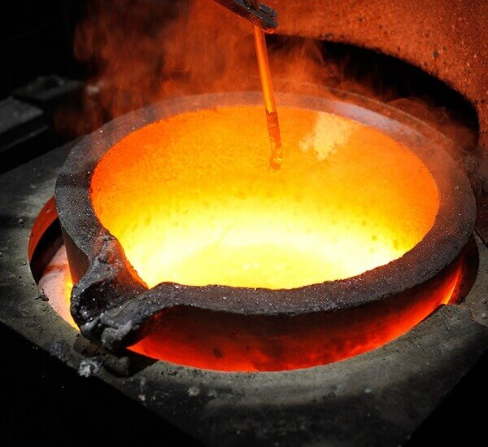
Operation in which a workpiece is given a specific shape or
form by means of a rotating cutter having many cutting teeth.
The process of heating ores to a high temperature in the
presence of a reducing agent such as carbon (coke) and of a fluxing
agent to remove the gangue.
PLATING
SMELTING
ذوب
COINING
MACHINING
SMELTING
Conclusion

Slide 12
Brazing
CASTING
FORGING
MILLING
STAMPING
WELDING
PLATING
COINING
MACHINING
SMELTING
Conclusion

Slide 13
لحیم کاری
ریخته گری
آهنگری
فرزکاری
مهر زنی
جوشکاری
آبکاری
سکه زنی
ماشین کاری
ذوب
Brazing
CASTING
FORGING
MILLING
STAMPING
WELDING
PLATING
COINING
MACHINING
SMELTING
Conclusion

